Slide 1
Bishop Blanchet Robot Controls
FRC Rapid React 2022

Slide 2
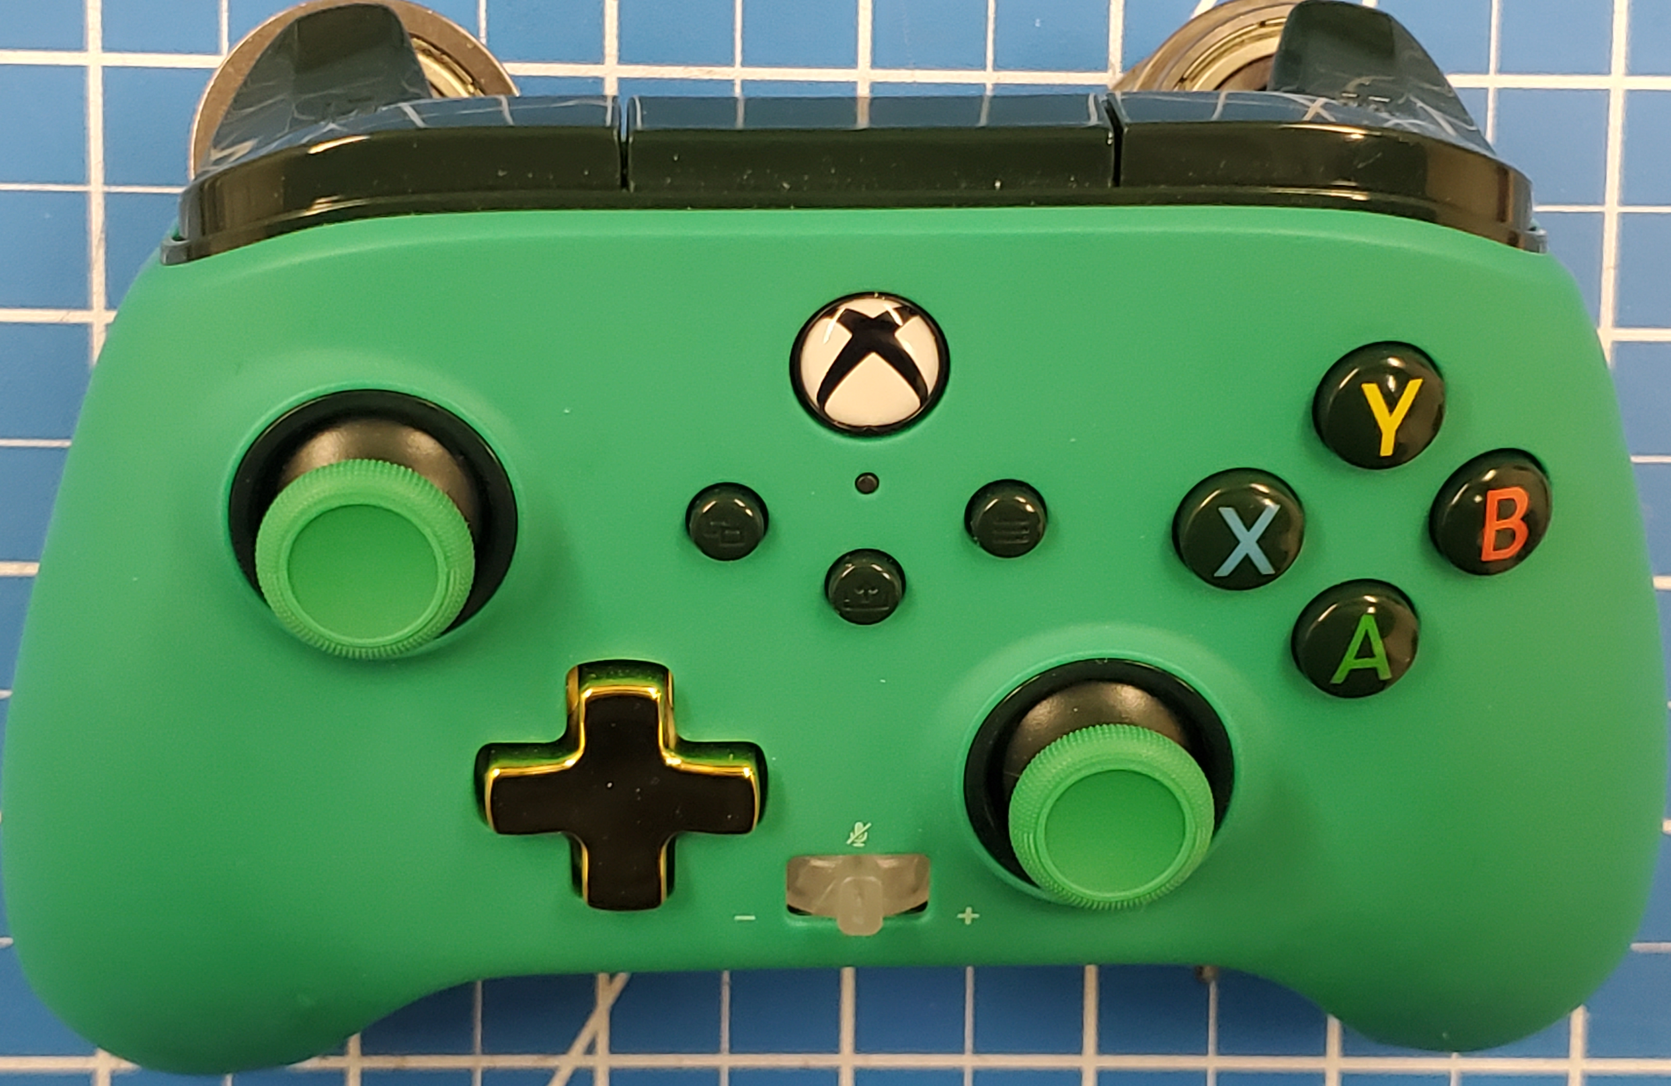
Driver Controller Actions
Left Joystick Button:
Arcade robot drive

Slide 3
Button Board Automated Commands
Climb Automation
Jaws
Ext & Pair
Mid
High
Traversal
Angle Arms
(engage/disengage toggles)
+
-
Command Stop
Telescoping Arms
Chassis
Jaws
Up
Down
High
Fwd
Low
Fwd
High
Rev
Intake
Low
Rev
Shoot
Intake
Left Paw
Right Paw

Slide 4
Button Board Mockup

Slide 5
Co-driver Controller Actions – overrides
Left Bumper: Stage 1 Ball Storage single speed (while pressed – ball storage stopped after release)
Right Bumper: Ball Retrieval
single speed (while pressed – ball storage stopped after release)
Right Trigger: Ball Shooter
variable speed
Left Trigger: Ball Intake
variable speed
Y Button: Angle Arm
top pneumatic in/out
(when pressed)
Left Joystick:
Ball Jaws up/down
variable speed
B Button: Angle Arm
bottom pneumatic in/out
(when released)
Left Joystick Button: Jaws Clutch lock/unlock
(when pressed)
Right Joystick:
Telescoping Arm up down
variable speed

